Slide 1
Differences between Arrays and Collections ?
momedaram

Slide 2
Arrays | Collections
1. Arrays are fixed in size. | 1. Collections are Growable in nature
2. Memory point of view arrays are not recommended to use. | 2. Memory point of view collections are highly recommended to use.
3. Performance point of view arrays are recommended to use. | 3. Performance point of view collections are not recommended to use.

Slide 3
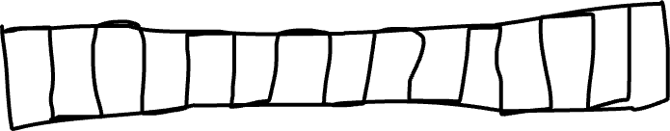

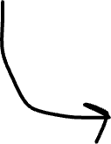




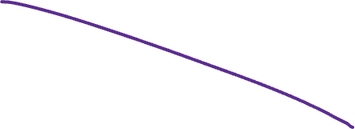
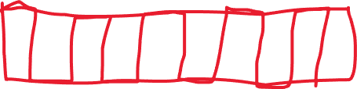
arrayList
6
7
8
9
1
2
3
4
5
10
1
4
5
6
7
9
2
3
8
10
11

Slide 4
Arrays | Collections
1. Arrays are fixed in size. | 1. Collections are Growable in nature
2. Memory point of view arrays are not recommended to use. | 2. Memory point of view collections are highly recommended to use.
3. Performance point of view arrays are recommended to use. | 3. Performance point of view collections are not recommended to use.
4. Arrays can hold only homogeneous data type elements. | 4. Collections can hold both homogeneous and heterogeneous elements.
5. There is no underlying data structure for arrays and hence there is no readymade method support. | 5. Every collection class is implemented based on some standard data structure and hence readymade method support is available.
6. Arrays can hold both primitives and object types. | 6. Collections can hold only objects but not primitives.

Slide 5
Thank You !
momedaram

